Slide 1
KINETIc facades as elements of contemporary and sustainable ARcHITEcTURE
Aleksandra Ćurčić, PhD student
Gordana Topličić Čurčić, PhD, Full Professor
Nataša Matić, PhD sudent
Dušan Ranđelović, PhD student
Faculty of Civil Engineering and Architecture, University of Niš, Serbia

Slide 2
1. INTRODUCTION
A building provides protection to the users of the space from external influences, while the building envelope is one of the primary subsystems that can be designed to attain an appropriate level of energy efficiency and comfort within the building.
Structures are affected by numerous natural and created factors that are not static, but dynamic. Therefore, it is important to improve the facilities so that they can adapt to changes in different conditions.
‘Adaptive façades, in particular, consist of multifunctional, highly adaptive systems, in which the physical separator between the interior and exterior space is able to change its functions, features, or behaviour over time in response to transient performance requirements and boundary conditions, with the aim of improving the overall building performances [4].‘

Slide 3
1. INTRODUCTION
In 1970, Zuk and Clark defined kinetic architecture as an architectural form that can be inherently displaceable, deformable, expandable, or capable of movement. To elaborate, a kinetic façade is a technological system in which there is a certain kind of motion and that is able to guarantee variable locations or mobility and/or variable geometry to all or one of its parts [10].
Kinetic facades are adaptable, responsive to natural and created influences by providing optimal building performance and user comfort.
The paper explains in more detail the concept of kinetic facades, as well as various design parameters that achieve the sustainability of a building and user comfort.
The aim of this paper is to present the advantages and significance of the application of modern design methods in architecture through the example of adaptive facades

Slide 4
2. ADAPTIVE FAcADEs
Adaptive facades represent a new generation of cladding systems aimed at reducing the energy consumption of buildings, as well as improving the comfort and sustainability of cities.
This is achieved owing to their ability to change their behavior in real time in accordance with internal and external parameters, using systems, components and materials.
In this way, the building becomes a dynamic system that adapts to the context of the environment in order to achieve an energy balance for smooth functioning, almost like a living organism.

Slide 5
2.1. The notion and concept of kinetic (dynamic) facades
The term kinetic originates from the Greek word kinesis, indicating motion, movement or the act of moving.
Kinetic architecture refers to the integration of a certain degree of movement within the structural design. Kinetic architecture can be defined as structures or parts of structures of variable mobility, location or geometry [11].
Dynamic facades are ‘facades with the ability to respond to their environment by either typological change of material properties that alter the overall form or local alteration by regulating their energy consumption to reflect the environmental conditions that surrounds it’ [6].

Slide 6
2.1. The notion and concept of kinetic (dynamic) facades
The concept of kinetic facades is based on movement, i.e. on the geometric transformation in space that affects the change of state, characteristics of materials, physical structure of the facade itself without compromising the overall structural integrity.
The application of kinetic facades improves the aesthetic qualities of the building, the response of the building to changes in environmental conditions, and performs functions that would be impossible for static facades.
Thanks to the mobility of these facades, the surface of the building changes so that it creates the effect of ‘skin-like articulation’, which encourages the idea that the building envelope is an active system, and not just a static divider.
The systems used can regulate the level of lighting, ventilation, i.e. air flow, energy, and even information.

Slide 7
2.2. Design parameters aimed at sustainability and positive impact on the user comfort
The following are the parameters that should be taken into account when designing facades, each of which has the potential to define the character of the building and affect its overall perception [6]:
Sunlight control and natural lighting are very important both because of the thermal comfort of the user and the view, and because of the reduction of the need for artificial lighting. With the help of shading, that is, shading elements that can be integrated into the facade itself, the amount of sunlight can be controlled, which achieves thermal comfort and the appropriate degree of illumination of the space.
By controlling the shading or natural lighting, it also provides the connection with the environment.
The building envelope plays a very important role in terms of ventilation control and natural ventilation. By adjusting and applying the appropriate elements on the facade, the optimal air flow is achieved.

Slide 8
2.2. Design parameters aimed at sustainability and positive impact on the user comfort
Thermal insulation systems that are properly integrated into the building envelope reduce energy consumption, as well as the comfort of users of the space throughout the year.
The choice of appropriate materials achieves the specific character of the building, affects the result of the external appearance of the building, as well as the proper functioning of the system and the comfort of the building.
As mentioned earlier, one of the main characteristics of kinetic and dynamic facades is the mobility of the facade elements without negative effects on the overall structure of the building.
In addition to saving energy thanks to some of the previously mentioned systems, the facade can be designed so that it itself becomes an energy generator.

Slide 9
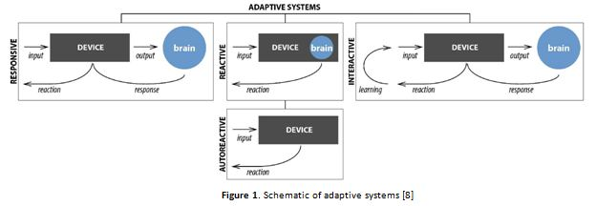
2.3. Systems and types of kinetic (dynamic) facades
The basic division of adaptive facade systems, which can be directly applied to kinetic facade systems depending on the way they are managed, is presented in Figure 1. These systems can be divided into responsive, reactive, interactive and autoreactive systems [8].

Slide 10
2.3. Systems and types of kinetic (dynamic) facades
Some of the possible approaches are the ‘whole building’ approach with a centralized management system, then floor-level management, or actuators on individual façade elements that can be operated by users or be self-reactive.
Building Management Systems are used in computer-controlled facades to manage conditions inside the building with the help of information from sensors located on the facade. These sensors detect various influences such as light levels, heat, wind speed, air quality [7].
Based on teh key influential factors on the facade design, a classification into the basic types can be made [2,6]:
User Control Kinetic Facade,
Light Control Kinetic Facade,
Energy Control Kinetic Facade,
Wind Responsive Kinetic Facade.

Slide 11
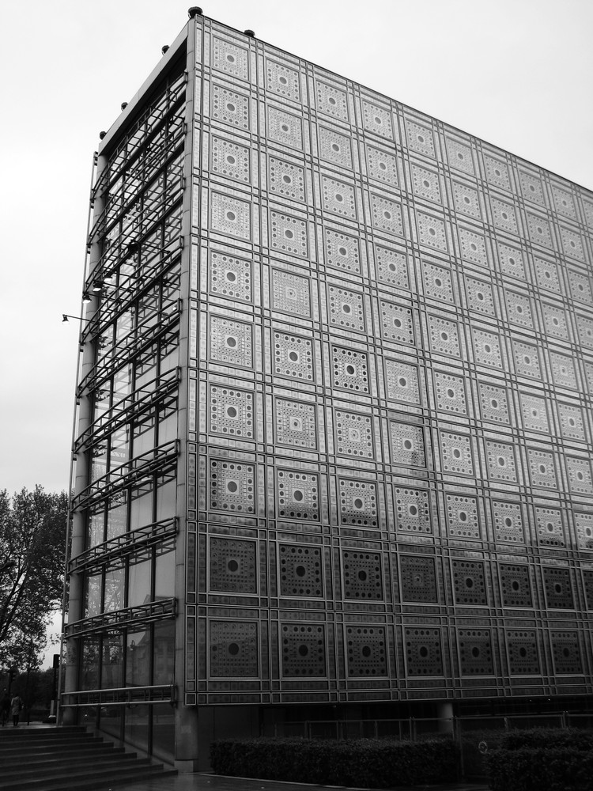
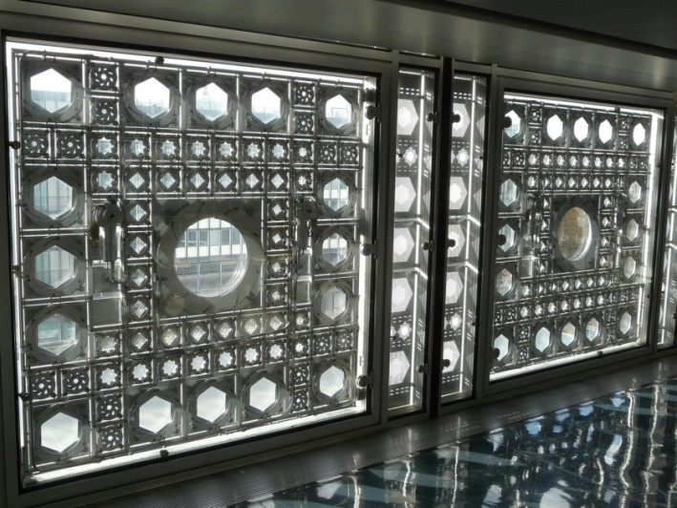
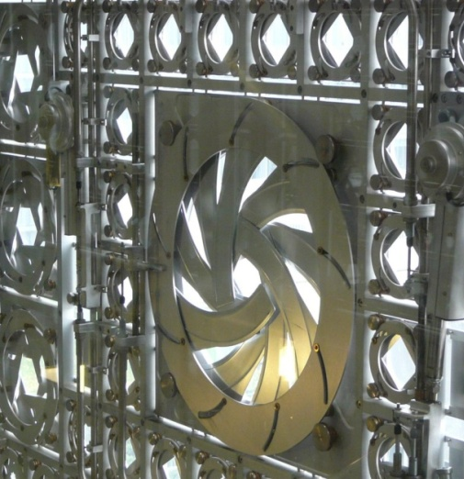
3. IMPLEMENTATION OF KINETIC FACADES – REVIEW OF CHOSEN EXAMPLES
Arab World Institute is the structure built in Paris (France) in 1987, and it was designed by the Atelier Jean Nouvel.
The southern facade of the building is covered by the power-actuated hexagonal lenses, Figure 2 (a). Their design takes after the ‘mashrabiya‘, lattice-work motif of Arabic architecture which provides partial shading and privacy while permitting view, Figure 2 (b).
The geometrical series is a combination of hi-tech photosensitive mechanical devices consisting of 30 000 diaphragms on 1600 elements supported on the frame of stainless steel, aluminium and glass.
The devices automatically adjust their openness / closeness every hour to match the outdoor changing light levels with the desired interior light level, filtering light in and out of the building throughout the day, Figure 2 (c).
Although the facade was designed with the goal of exploring light, reflections, contours and shadow, the concept itself can be implement as a shading system with the tendency to reduce the cooling system workload [1].
a)
b)
c)

Slide 12
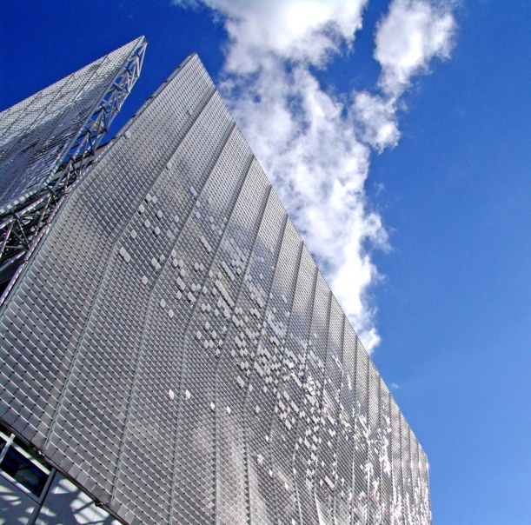
3. IMPLEMENTATION OF KINETIC FACADES – REVIEW OF CHOSEN EXAMPLES
Articulated Cloud is situated in (USA); it was built in 2004 and designed by Ned Kahn and Koning Eizenberg Architecture, Figure 3. (a).
The building façade transforms into a wind sculpture owing to 43 000 individual lightweight plastic elements affixed on a steel frame screen, Figure 3 (b). Composed of thousands of white squares moving in the wind, Figure 3 (c), envelope of this building appears as a digitalized cloud. The optical qualities of the envelope vary depending on weather and time of day [1].
a)
b)
c)

Slide 13
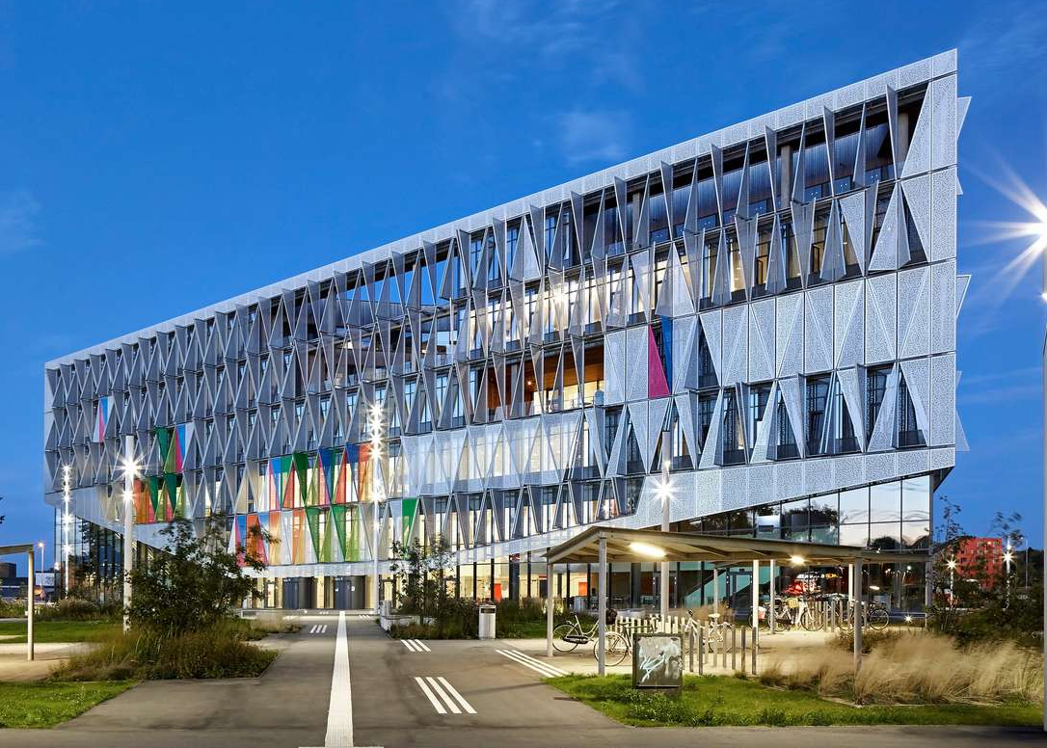
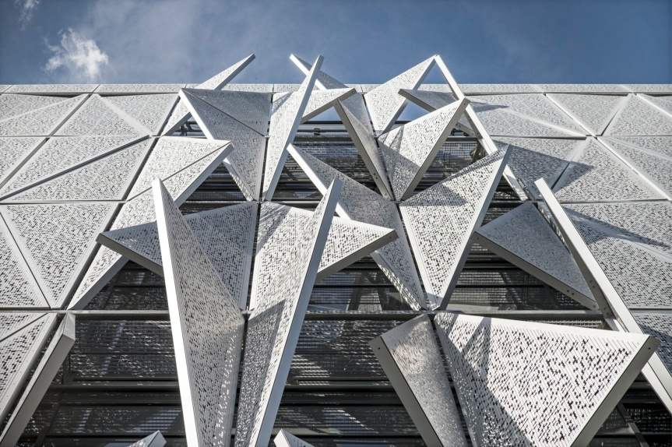
3. IMPLEMENTATION OF KINETIC FACADES – REVIEW OF CHOSEN EXAMPLES
Campus Kolding, built in 2014 in Kolding (Denmark), was designed by Henning Larsen Architects, Figure 4 (a).
The building façade consists of 1600 perforated steel shading panels. These triangular shaped solar shading devices are controlled by sensors that monitor light and heat levels around the building, adjusting themselves by either opening or closing automatically, Figure 4 (b).
Sensors monitor heat and light levels around the building, allowing the facade panels to shift from open to half-open to fully open. This system provides the optimum light and thermal user comfort. The building features a number of sustainable features, for instance cooling by means of water from Kolding River, mechanical low-energy ventilation and solar cells [1].
a)
b)

Slide 14
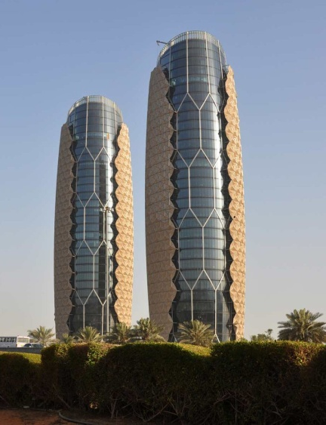
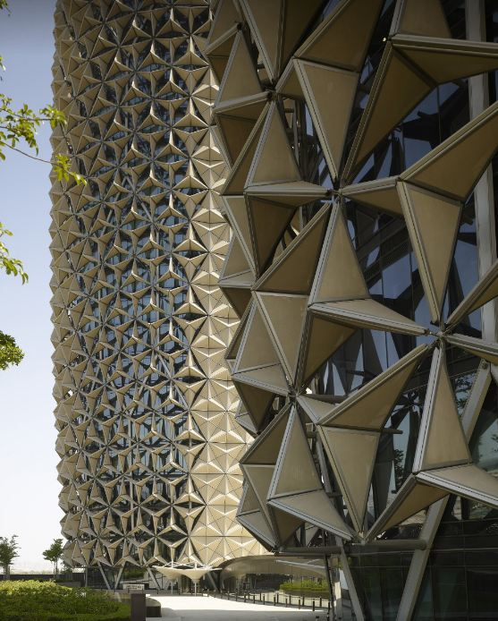
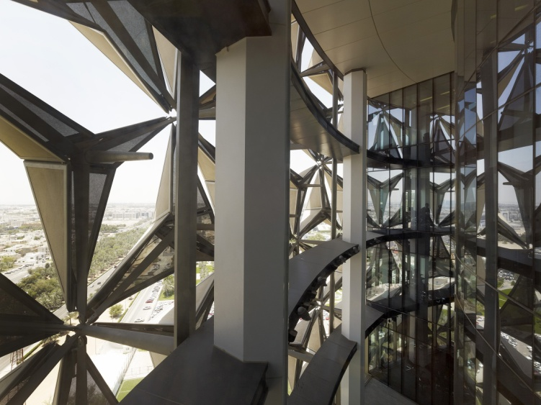
3. IMPLEMENTATION OF KINETIC FACADES – REVIEW OF CHOSEN EXAMPLES
One of the most famous examples of kinetic facades are Al Bahar Towers in Abu Dhabi (AE), Figure 5 (a). They were built in 2012 and the design was produced by Aedas Architects, Ltd.
The ‘mashrabiya‘ at Al Bahar Towers comprises a series of transparent umbrella-like components that open and close in response to the sun’s path. Each of the two towers comprises over 1.000 individual shading devices that are controlled via the Building Management System, creating an intelligent façade, Figure 5 (b).
The tower curtain wall is comprised of unitized panels separated from the kinetic shading system through a substructure by means of movement joints. The dynamic shading system is a screen comprised of triangulate units such as origami umbrellas, Figure 5 (c). The triangular units act as individual shading devices that unfold to various angles in response to the sun’s movement in order to obstruct the direct solar radiation [1].
a)
b)
c)

Slide 15
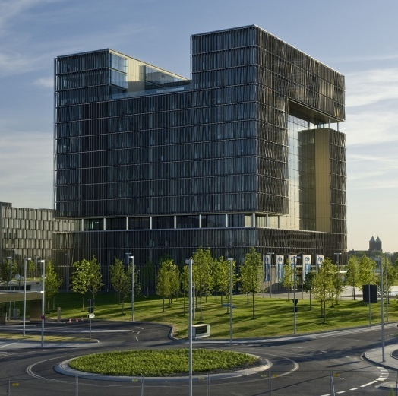
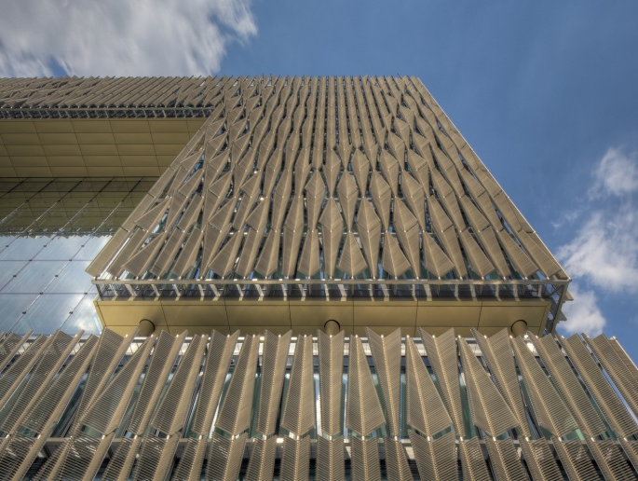
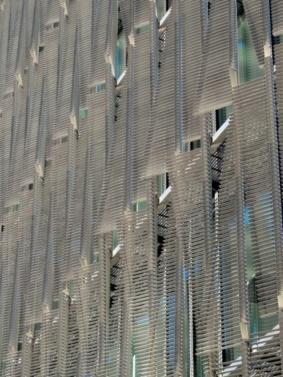
3. IMPLEMENTATION OF KINETIC FACADES – REVIEW OF CHOSEN EXAMPLES
Thyssenkrupp Quarter u Essen (DE) was designed in 2010 by JSWD Architekten + Chaix & Morel et Associés, Figure 6 (a).
The exterior of the structures is clad in steel sheets of incomplete texture. The Headquarter façades have metallic sun shades which are comparable to vertical moveable feathers, Figure 6 (b).
These feathers consist of an axis with two series of horizontal slats on either side; the «barbs» enable the amount of sunlight entering the building to be regulated. When the barbs of the two neighbouring feathers are open they can crisscross each other and superimpose themselves to allow a maximum amount of sunlight to enter the building, Figure 6 (c).
Around 400 000 of centrally controlled slats offer protection from sunlight, without obstructing the view. The primary parameter setting the façade system in motion is the outdoor air temperature [1].
a)
b)
c)

Slide 16
4. CONCLUSION
The paper presents the main characteristics of adaptive facades with special reference to kinetic facades. The concept of these facades is explained in more detail, as well as the basic systems and typology.
Considering the importance and topicality of sustainability in construction, the most important parameters that should be paid attention to when designing facades are listed.
Based on a brief analysis of selected examples, a wide range of applications of kinetic facades and a variety of systems that adapt to different environmental conditions can be seen.
It can be concluded that the envelopes of buildings play a significant role in the energy efficiency of buildings and the comfort of space. They are most often used in the form of shading systems, with the regulation of natural ventilation and temperature inside buildings.
Due to advances in technology and materials, kinetic facades can evoke a strong and unique aesthetic impression.
Adaptive facades as an element of modern architecture provide the potential for permanent progress in terms of development of building skins.

Slide 17
ACKNOWLEDGEMENTS
This research is supported by the Ministry of education, science and technological development of the Republic of Serbia for project cycle 2011-2020, within the framework of the projects TR 36045 and TR36017.

Slide 18
References
1. Aelenei, L., Aelenei, D., Romano, R., Mazzucchelli, E.S., Brzezicki, M. and Rico-Martinez, J.M., 2018. Case Studies-Adaptive Facade Network. TU Delft Open for the COST Action 1403 adaptive facade network, EU.
2. Bakr, A.O., 2019. Kinetic Facades the new Paradigm Shift in Architecture toward an Environmental Design Performance, Journal of Arts, Literature, Humanities and Social Sciences, Vol 43. pp. 577-590.
3. Hammad, F. and Abu-Hiljeh, B., 2010. The energy saving potential of using dynamic external louvres in an office building. Energy and Buildings, Vol 42 Issue 10. pp. 8.
4. Loonen, R.C.G.M., Rico-Martinez, J.M., Favoino, F., Brzezicki, M., Menezo, C., La Ferla, G., & Aelenei, L. ,2015. Design for façade adaptability – Towards a unified and systematic characterization. Proceedings of the 10th Conference on Advanced Building Skins, Bern, Switzerland, pp.1284-1294.
5. Lopez, M., Rubio, R., Martin, S. and Croxford, B., 2017. How plants inspire façades. From plants to architecture: Biomimetic principles for the development of adaptive architectural envelopes. Renewable and Sustainable Energy Reviews, Vol 67. pp. 692-703.
6. Nady, R., 2016. Dynamic Facades Environmental Control Systems for Sustainable Design. Proceedings of the First International Conference on New Trends for Sustainable Energy, Alexandria, Egypt. pp. 118-127.
7. Ogwezi, B., Bonser, R., Cook, G. and Sakula, J., 2011. Multifunctional, Adaptable Facades. Proceedings of the TSBE EngD Conference, University of Reading, Whiteknights, UK.
8. Persiani, S., Battisti, A. and Wolf, T., 2016. Autoreactive architectural facades – discussing unpowered kinetic building skins and the method of evolutionary optimization, Proceedings of the 11th Conference on Adaptive Building Skins, Bern, Switzerland
9. Premier, A., 2012. Dynamic Facades and Smart Technologies for Building Envelope Requalification. Screen City, Issue 01. pp. 65-69.
10. Romano, R., Aelenei, L., Aelenei, D. and Mazzucchelli, E.S., 2018. What is an Adaptive Façade? Analysis of Recent Terms and Definitions from an International Perspective. Journal of Facade Design and Engineering, Vol 15 Number 3. pp. 65-76
11. Ron, R., 2012. Exploration of Eco-Kinetic Systems in Architecture Development of dynamic interactive building elements. Human-Computer Interaction, Vol 2. pp. 381-390.
12. Sharaidin, K.H., 2014. Kinetic Facades: Towards design for Environmental Performance. (Unpublished doctoral dissertation), RMIT University, Melbourne, Australia.

Slide 19
THANK YOU FOR YOUR ATTENTION!

